Slide 1
Pizzahut
Sales

Slide 2
About Me
Hi..!!!
I am Latika an aspiring Data Analyst.
Pizzahut Sales project in SQL
In this project I find some business related question which help the organization to increase the sales.
*Like which pizza category is mostly liked by the customers .
*In which Hour sales is very high.

Slide 3
Total number of orders
21350
Total revenue
817860.05

Slide 4

Highest-Priced Pizza

Slide 5

The most common pizza size ordered.
Large size pizza is the most sold pizza size.
Second most sold pizza size is medium one.

Slide 6
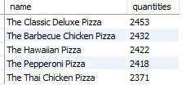
List the top 5 most ordered pizza type along with their quantities.
The classic Deluxe Pizza and barbecue chicken Pizza have very tough compition.

Slide 7

Total quantity of each pizza category ordered.
Classic
14888
Veggie
11649
Supreme
11987
.

Slide 8
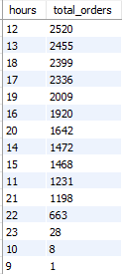
Distribution of orders by hours of the day
That means in the afternoon we are getting more orders.

Slide 9

Top 3 most ordered pizza based on revenue

Slide 10
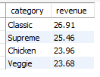
The percentage contribution of each pizza type to total revenue.

Slide 11
THANK YOU

